Slide 1

How TO BE ADMIRABLE at work: Business Etiquette
Tim Rodgerson

Slide 2
Intro
5 Areas
Benefit
Agenda
What?
Why?
Where?
When?
Who?
How?
Notes:
Review who benefits and tips on how to maintain business etiquette

Slide 3
Meet Joe
Upset at work
Tension from employees
Rumors about products
Notes:
Regional manager for an electronics depot store

Slide 4

What is Etiquette?
the expected behavior in any situation
Notes:
Fortunately, Joe know the perfect solution to relief some pressure on himself and the rest of the company. He’s going to use proper business etiquette.

Slide 5

Why?
Fired
Negative Publicity
Loss of customers/clients
Notes:
Its important that joe develops good business etiquette because

Slide 6
Intro
5 Areas
Benefit
Navigation
What?
Why?
Where?
When?
Who?
How?
Notes:
Now moving on the 5 areas that business etiquette is essential and when to use it.

Slide 7





The Five Areas
Workplace
Social Settings
Online
Telephone
Mobile Device
Notes:
Workplace is the most obvious as you spend the most time there but expands into 4 other categories as well

Slide 8

The Workplace
Be on time
Avoid powerful scents
Refrain from emotional topics
Stay home when sick
Notes:
Respect others time and space; don’t be late

Slide 9
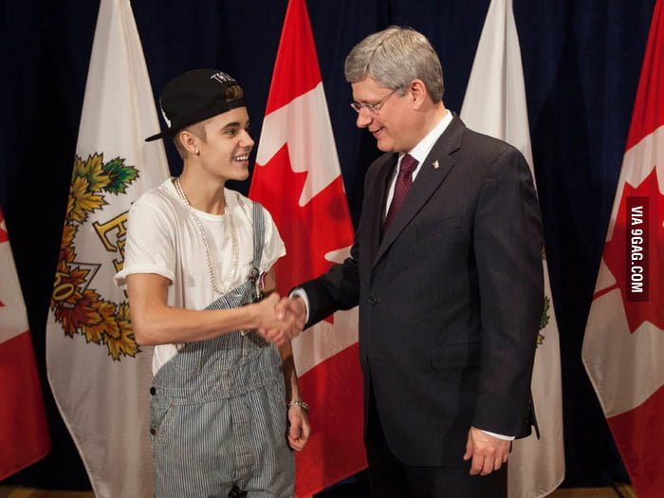
Personal Appearance
Shows respect for organization
Dress by observation
4 styles

Slide 10

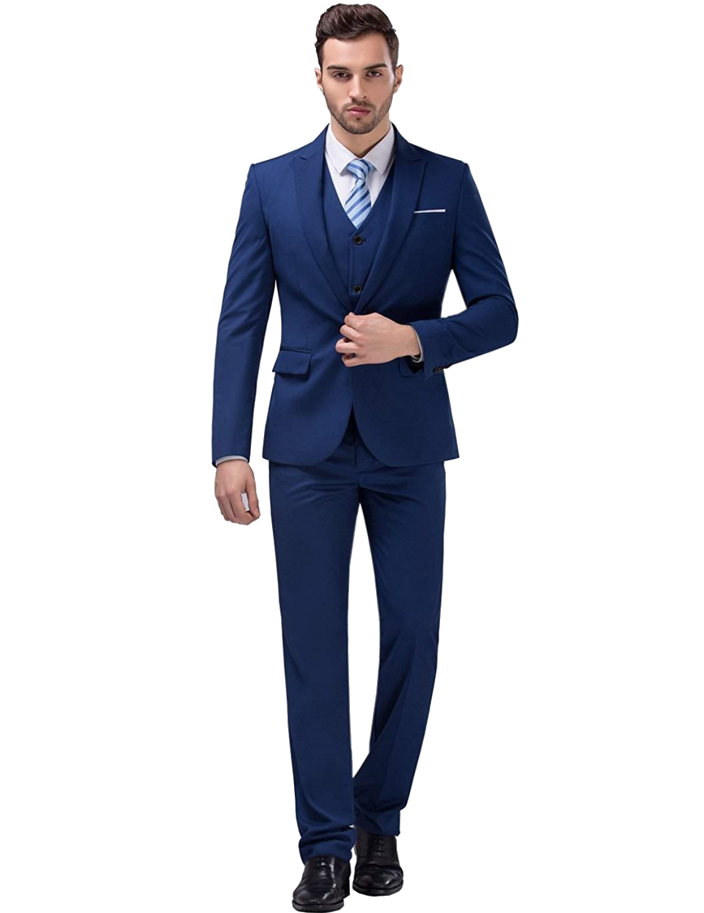
Business Formal
Suits with conservative colors
Groomed
Top level and high profile

Slide 11
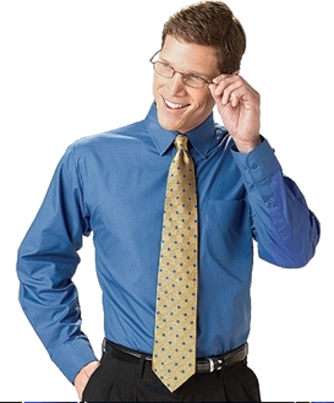
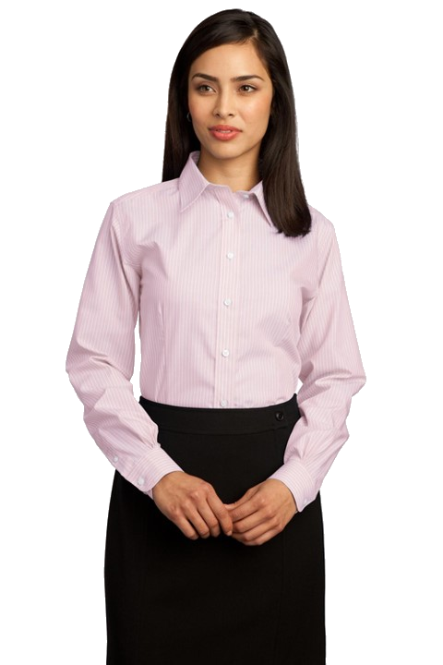
Business
Professional
Based upon suits
Neutral colors
Lawyers or Bankers

Slide 12
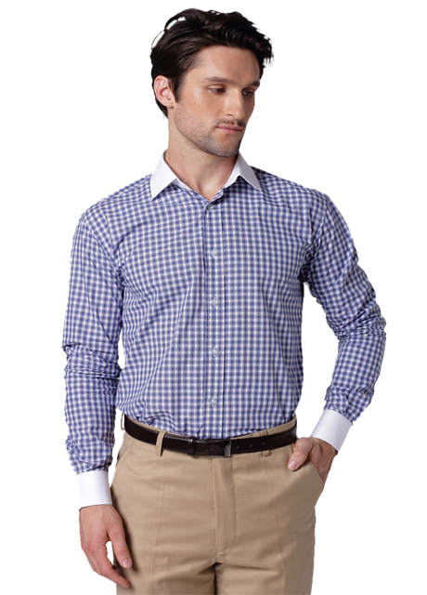

Business Casual
More expressive
Still nice and neat
Polos, blouses, sweaters
Teachers or social workers

Slide 13


Casual
Everyday clothes
Still has dress code
T-shirts, shorts, tanks tops
Wide range of jobs
Don’t be afraid to ask

Slide 14
I look much better!
Before
After
Notes:
Joe’s first step to improving his business etiquette is changing his outfit. Better represents company.

Slide 15

Social Settings
Conferences or launches
Publicly represent company
Understand cultural norms
Initiate conversation
Don’t serve messy foods
Notes:
Company parties, handshake USA – head nod Japan, in charge

Slide 16
Wait! I’ll introduce Steve
I don’t know anyone. Bye!
Notes:
Joe’s next step is to host a Christmas party for the store managers for his region, so his employees are more familiar and comfortable with each other.

Slide 17

Online
Maintain high standards
Stay focused
No personal attacks
Full attention to messages
Careful of comments
Notes:
Easy to about etiquette on the internet but one must maintain high standards, not trolling
Top executives on the news because of social media comments

Slide 18
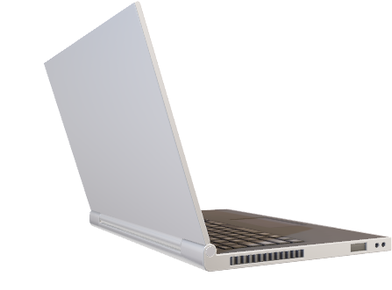
Notes:
Now joe remembers all the questionable comments he made on Facebook when he was young and goes to delete them. Also, makes a mental note not to discuss personal opinion on blogs and websites as name and company name are shown in comments sections

Slide 19

Telephone
Be aware of pitch
Talk slow to nonnative speaker
Smile
Voicemail is last resort
Notes:
If need to leave message use different medium or channel
Other hand, don’t have a silly voicemail setup for your number

Slide 20
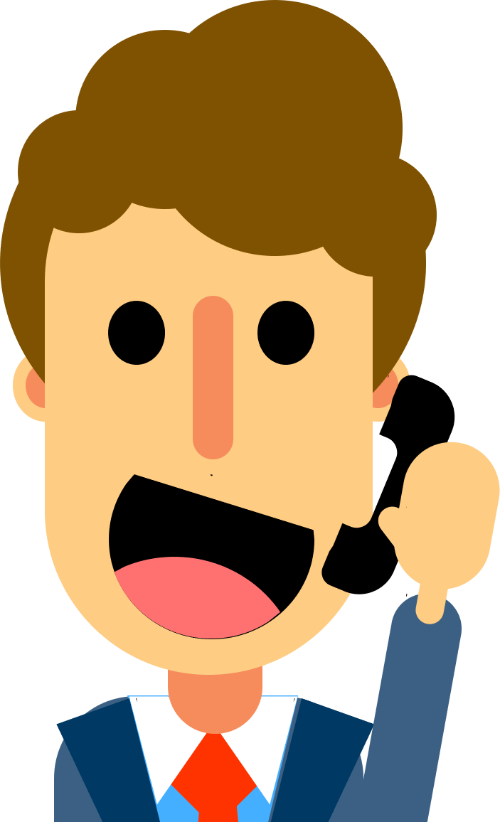
Have a great day, goodbye!
Notes:
Joe’s next step is to no let his emotions be heard in conversation

Slide 21
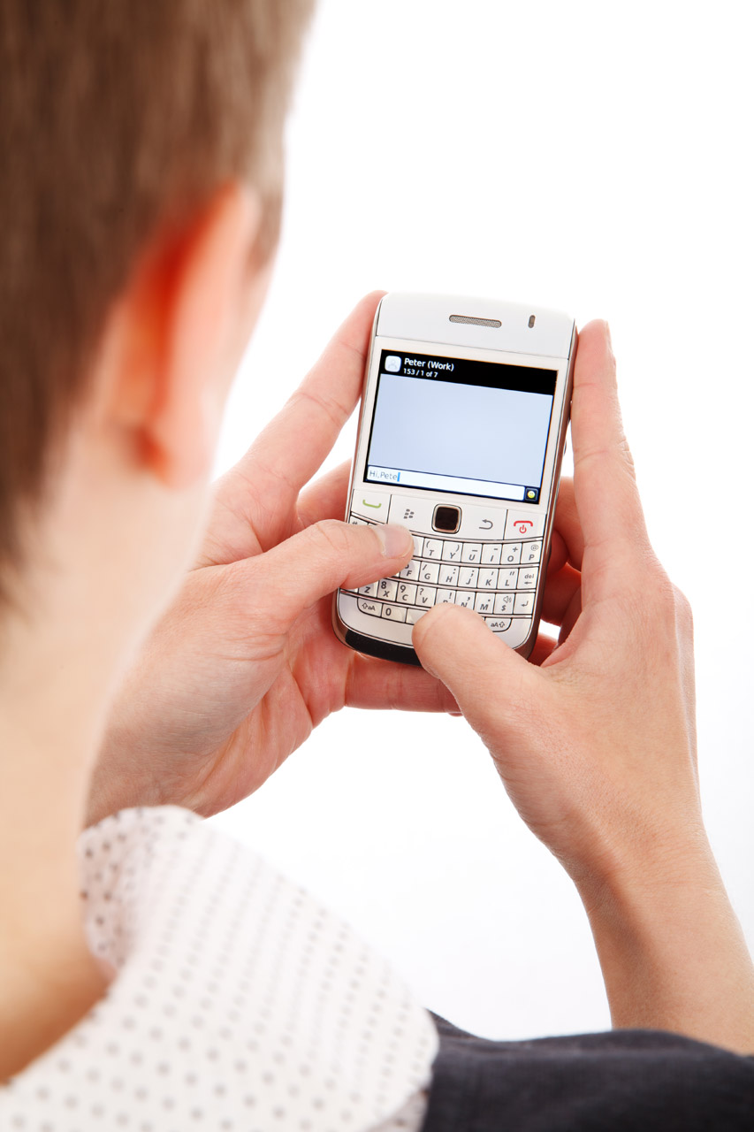
Mobile Devices
No loud ringtones
Taking unnecessary calls
Photos without permission
Voice recognition
Notes:
Finally we have

Slide 22
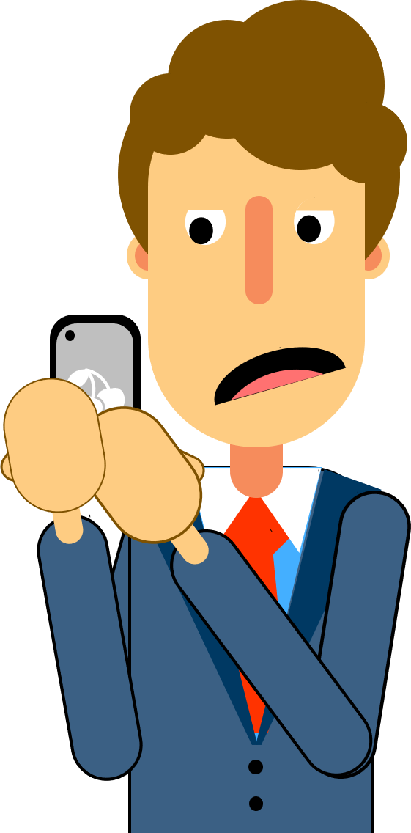
silence phone before meeting
Notes:
Joe’s final step to improving his business etiquette is making the mental note to always silence his phone before meetings

Slide 23
Intro
5 Areas
Benefit
Navigation
What?
Why?
Where?
When?
Who?
How?
Notes:
Now I will explain who benefits from proper business etiquette
Provide tips on how to remember the rules

Slide 24

Benefits
Better environment
Boosted Employee Moral
Promotes
Growth
Enhance
Relationships
Higher
Productivity
Notes:
Overall good business etiquette will better the environment and provides a better space for the whole company
Enhances employee relationships and customer
Boost morale because employees enjoy being at work
Higher productivity because employees are do better work and are more efficient

Slide 25
Congratulations!
Joe was promoted!
Notes:
Because of joe’s efforts in improving his etiquette joe has been promoted to vice president of operations

Slide 26



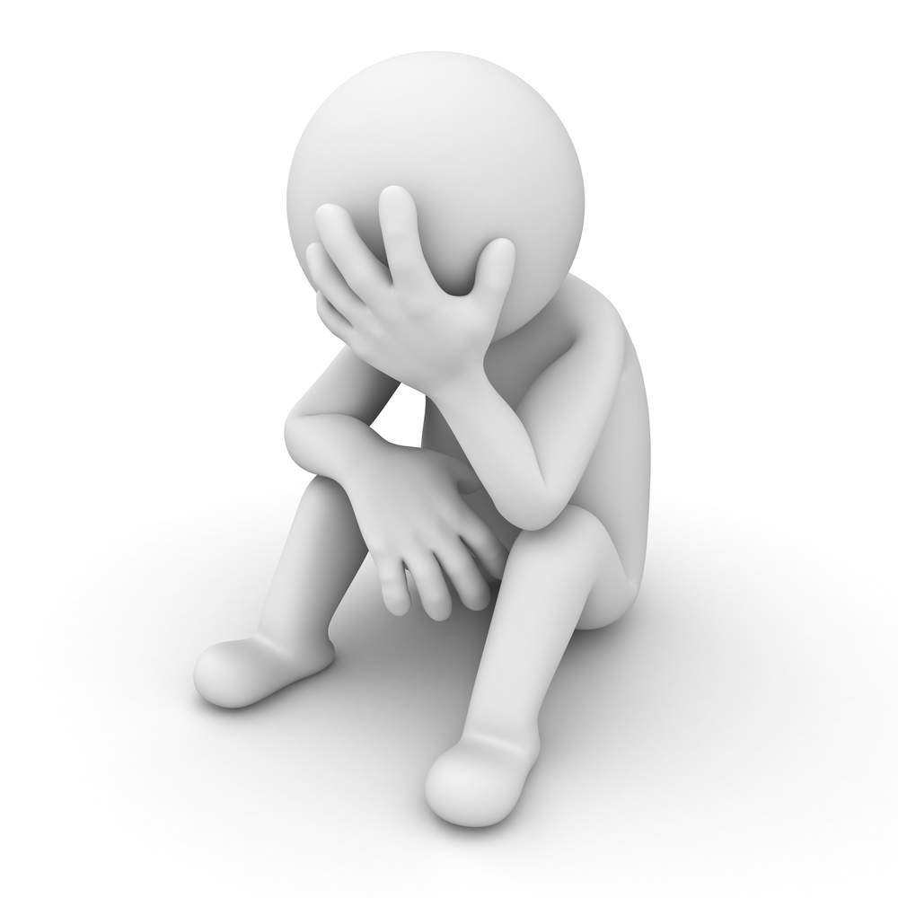

Tips
Be aware of personal impact
Make good
first impressions
Be collaborative
Teamwork
Keep emotions
in check
Notes:
To wrap here are some tips for maintain etiquette instead remembering each rule

Slide 27
Conclusion
Workplace
Social
Settings
Mobile
Device
Telephone
etiquette is essential to a professional career
Online
Notes:
To sum everything up, business etiquette is the expected behavior in any situation and
Is beneficial to one’s career
5 areas are

Slide 28
Bibliography
MyLab Business Communication with Pearson eText -- Combo Access Card -- for Excellence in Business Communication
Edition: 13th
ISBN: 9780135642856
Author: Thill
Publisher: Pearson Education
Thank you
Notes:
I just want to thank you all for your time and allowing me to demonstrate how business etiquette is essential to one’s career
I hope you all enjoyed

